Slide 1

INF05100 FINAL PROJECT
Eco System for Market & Factory
TEAM19 PRESENTATION
Jiaqi Zhang - 001057288
Yajie Li - 001087420
Mingda Ju - 001810212
Northeastern University

Slide 2
Problem Statement
Require a system to manage enterprises, organizations and employees
Need to improve the efficiency of information exchange within and between enterprises
Northeastern University

Slide 3
Solution to the Problem
Enterprises can manage their organizations and employees
Every employees have their account, so they can manage their request
Request can be pushed between different roles
Northeastern University

Slide 4
Approach
Set Admin role to manage the account of users
Design reasonable work flows to address enterprises and employees need
Use DB4O
Northeastern University

Slide 5
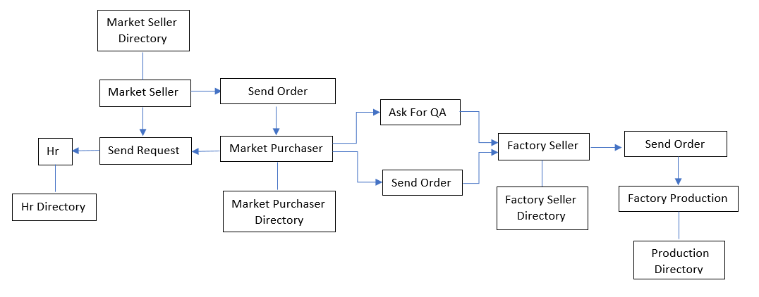
Object Model
Northeastern University

Slide 6
Work Flow
Order Management
Market Seller will send order request to Market Purchaser.
Market Purchaser will handle these orders, then forwards the order to the Factory Sellers.
Factory Sellers will forward these orders to Production.
Market Purchaser will require the Quality Assessment from Factory Sellers.
Northeastern University

Slide 7
Work Flow
B. HR Management
The employees in different Market Deferent can send requests to HR Organization
Two Cross-Enterprise Requests
Four Cross-Enterprise Requests
Northeastern University

Slide 8
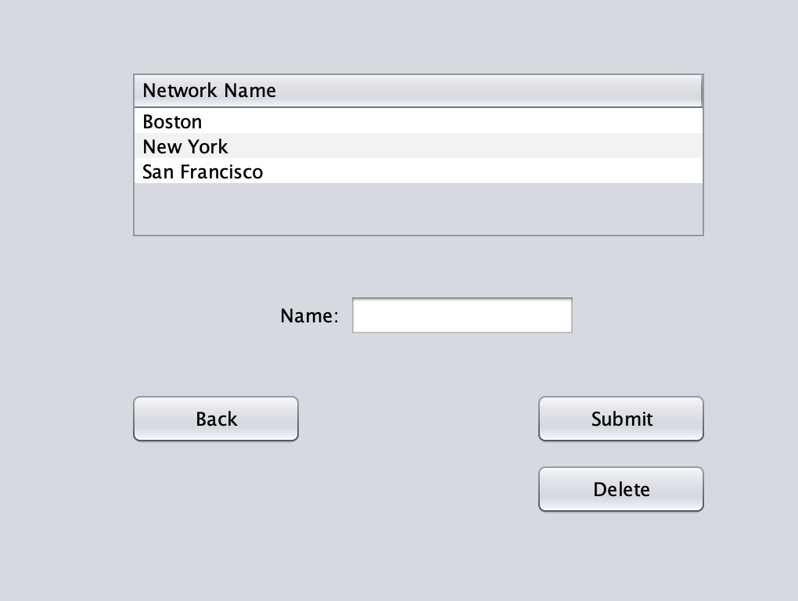
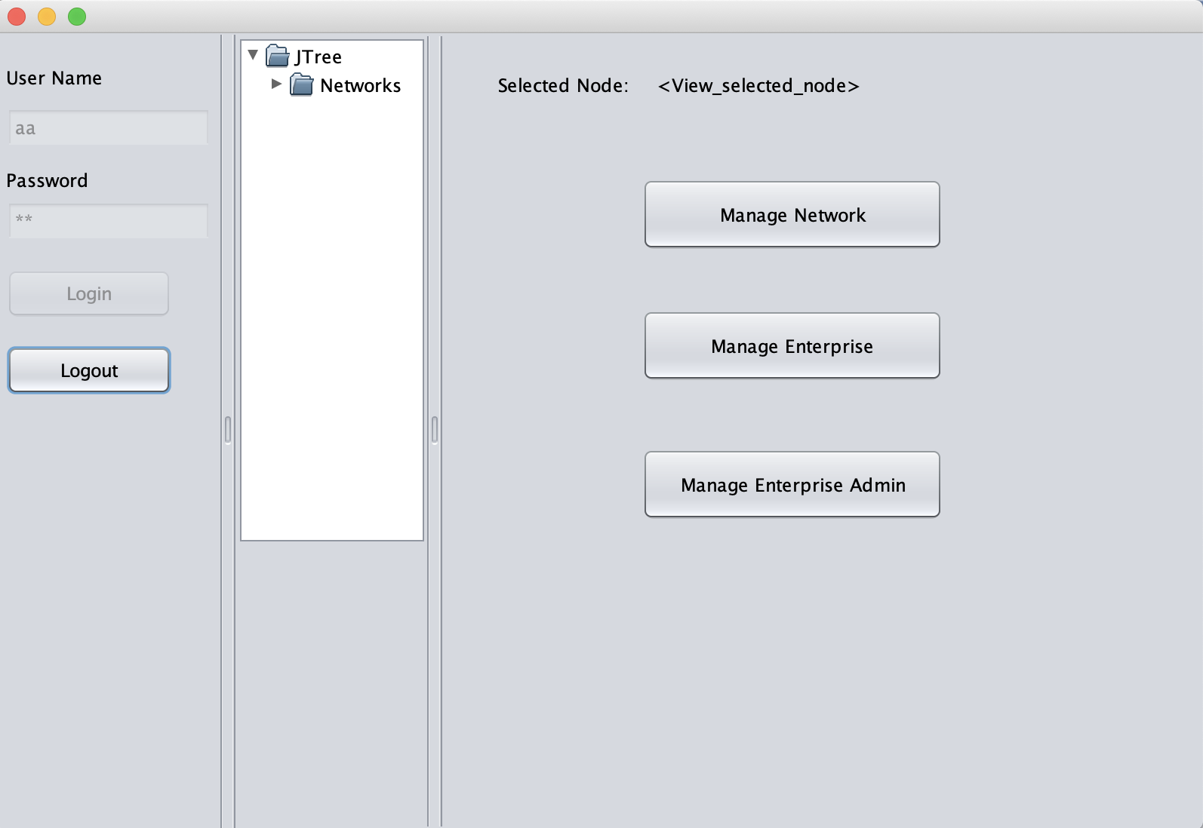
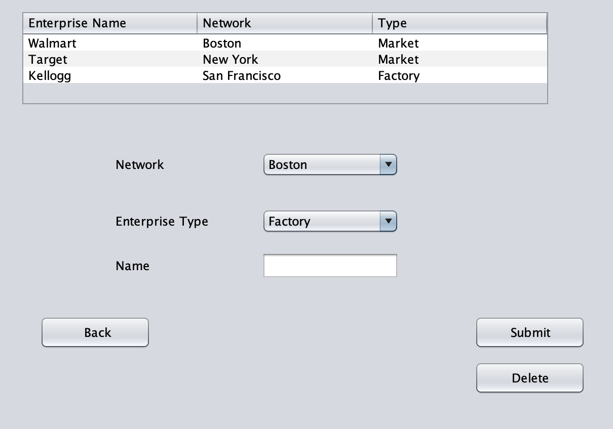
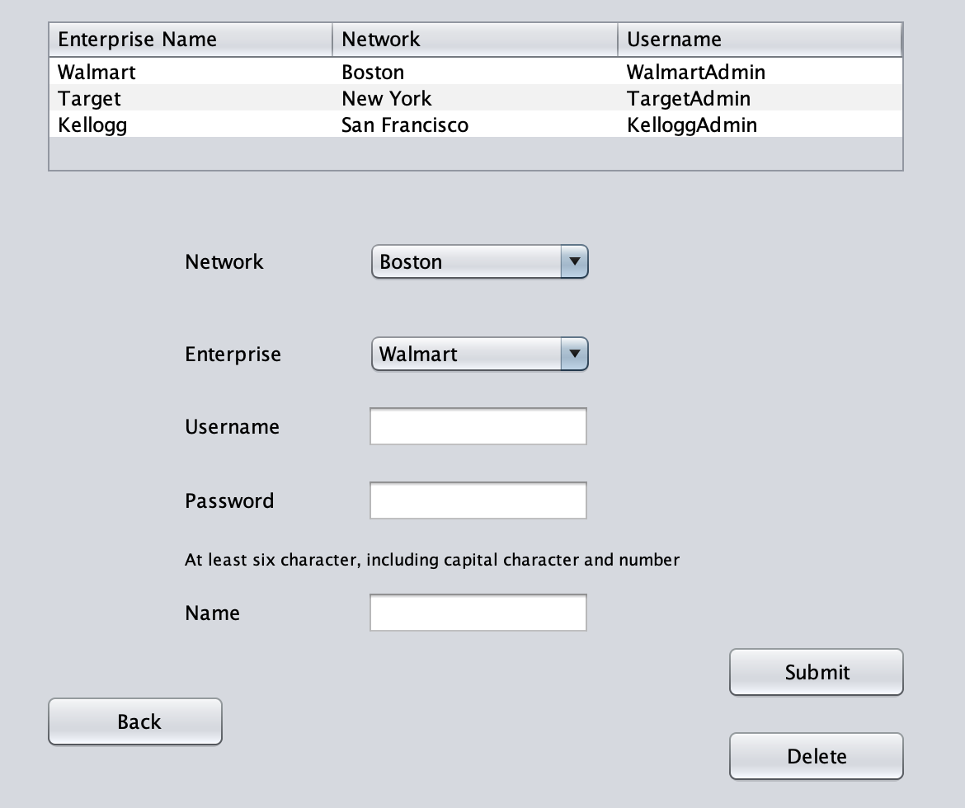
Use Case
SystemAdmin Role

Slide 9
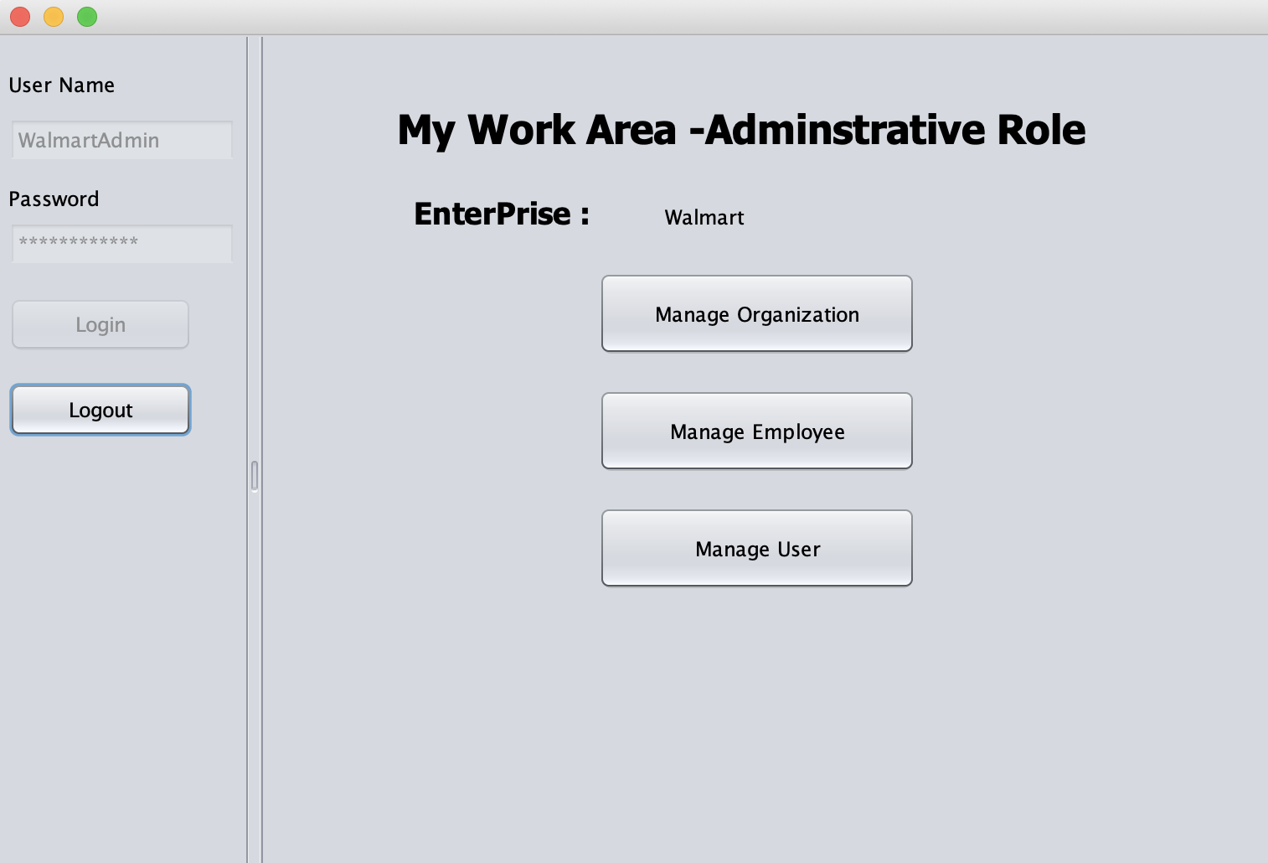
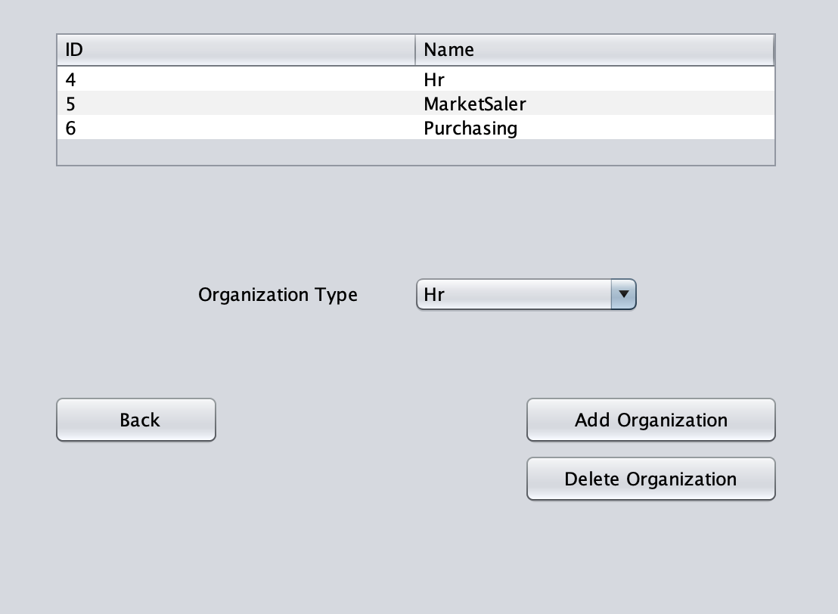
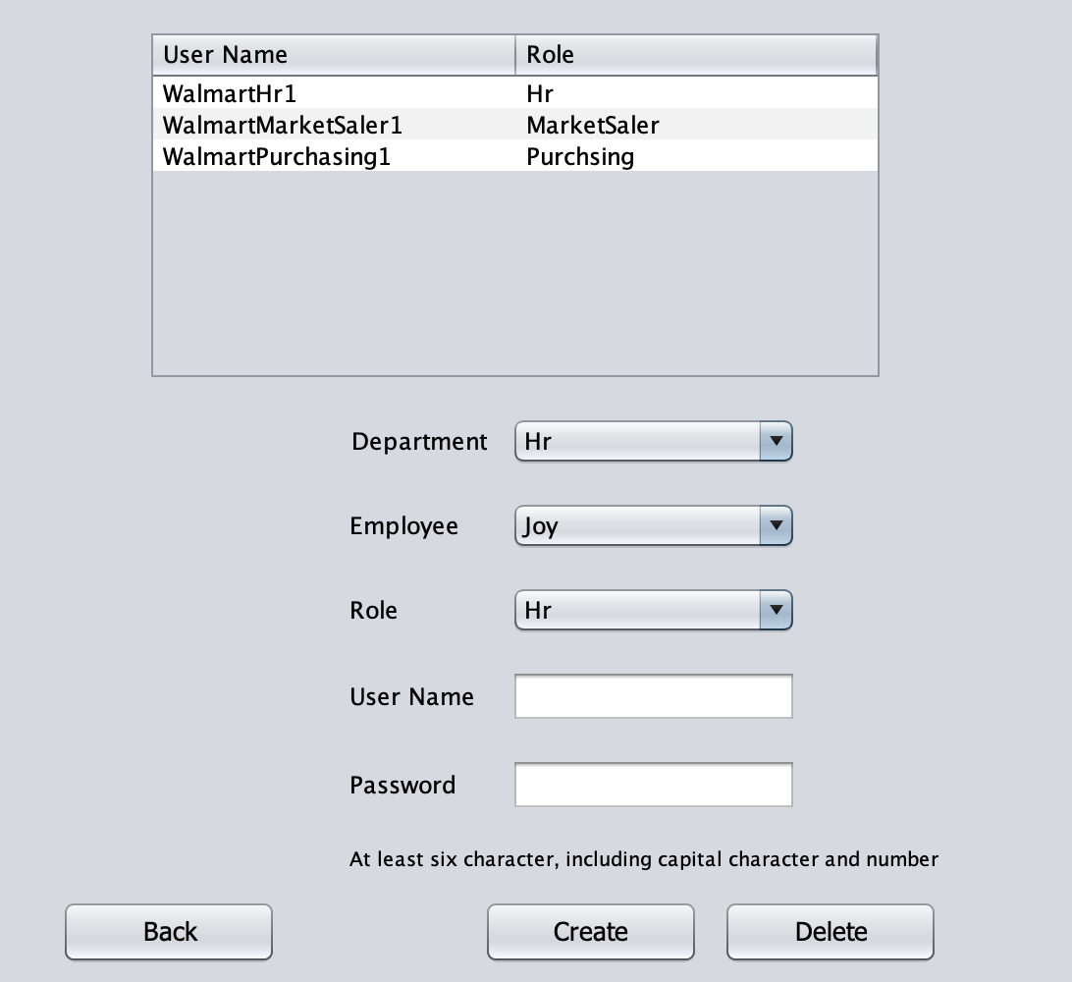
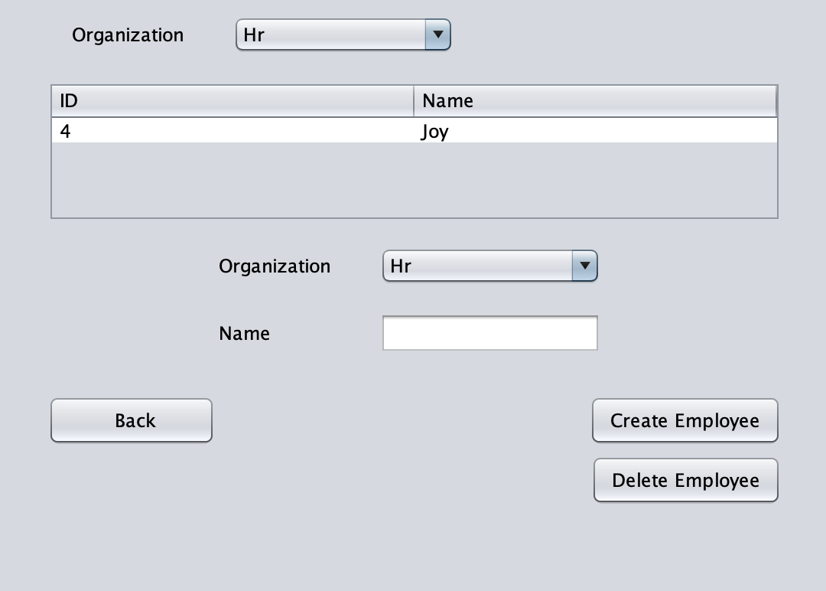
EnterpriseAdmin Role

Slide 10
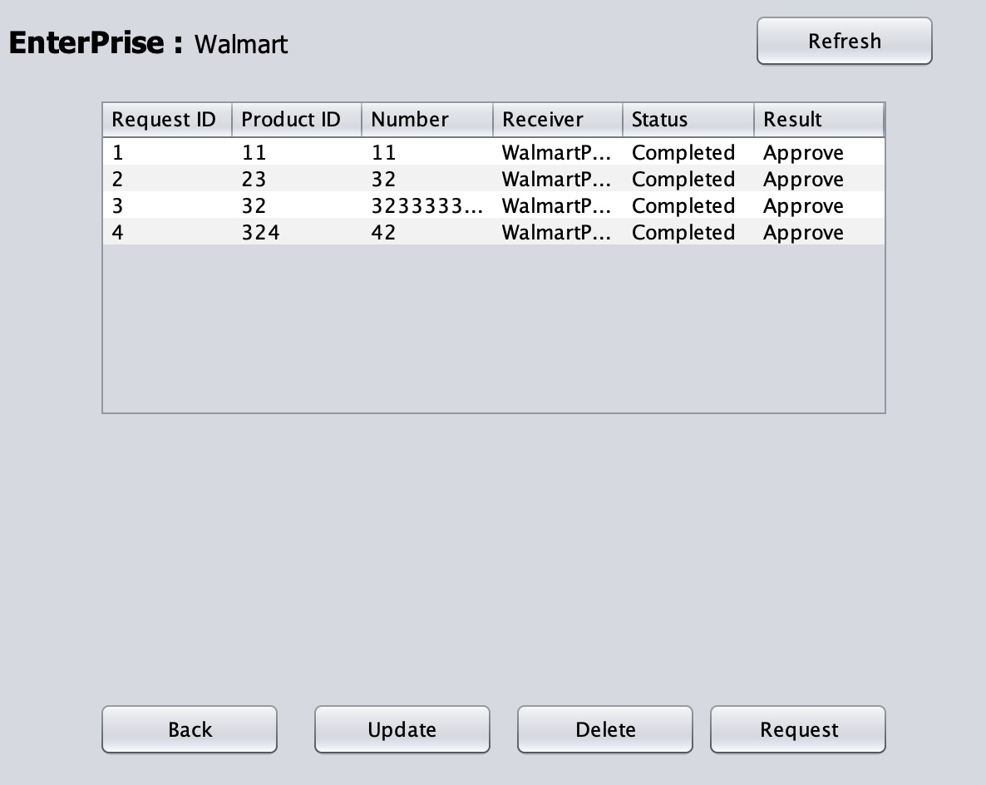
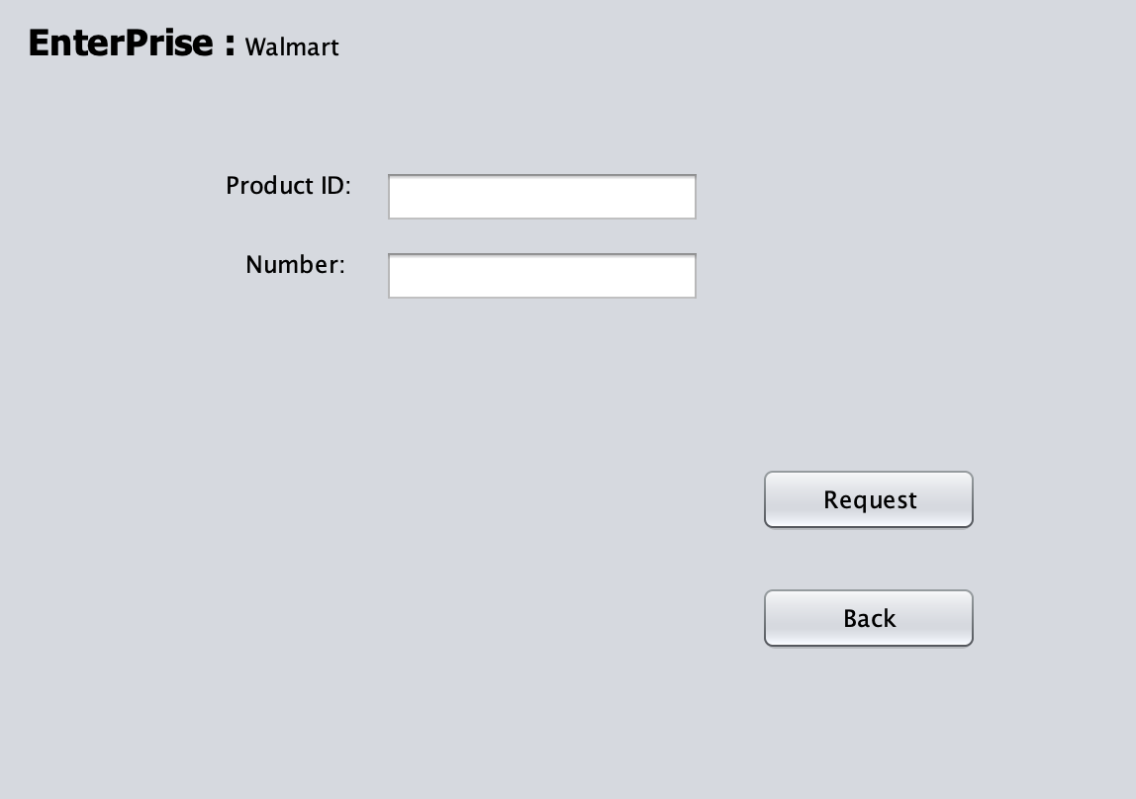
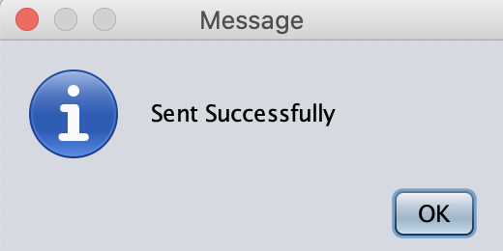
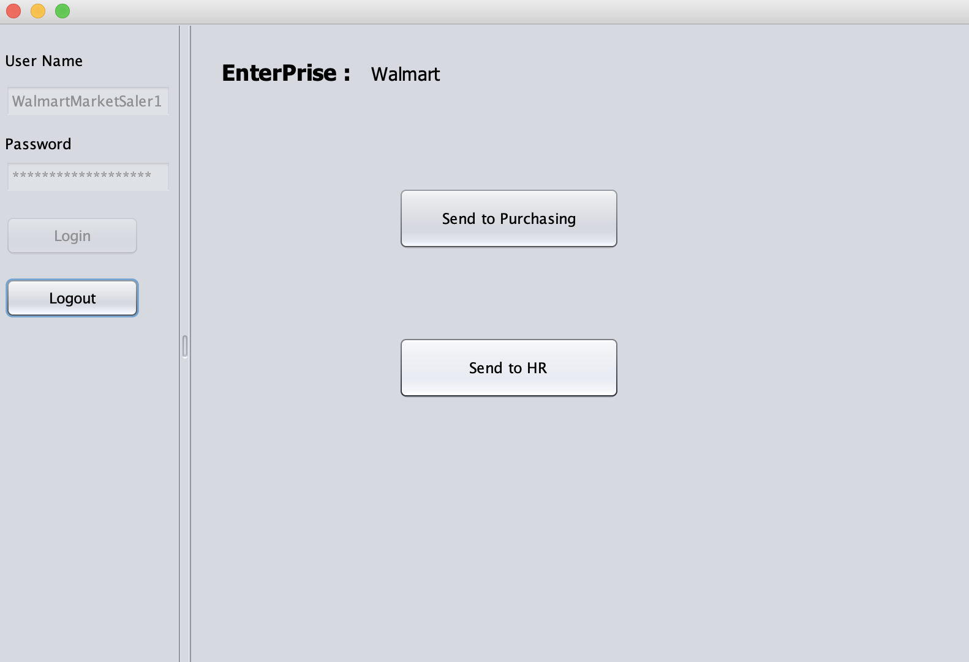
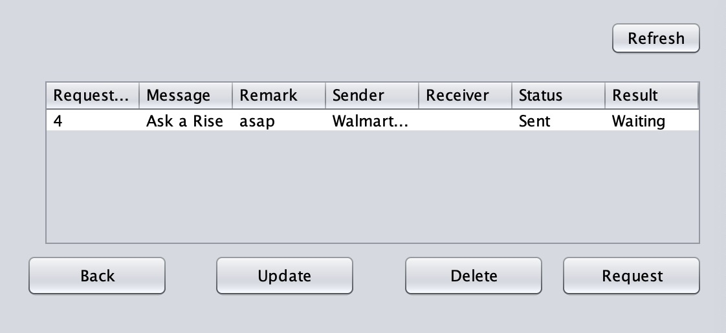
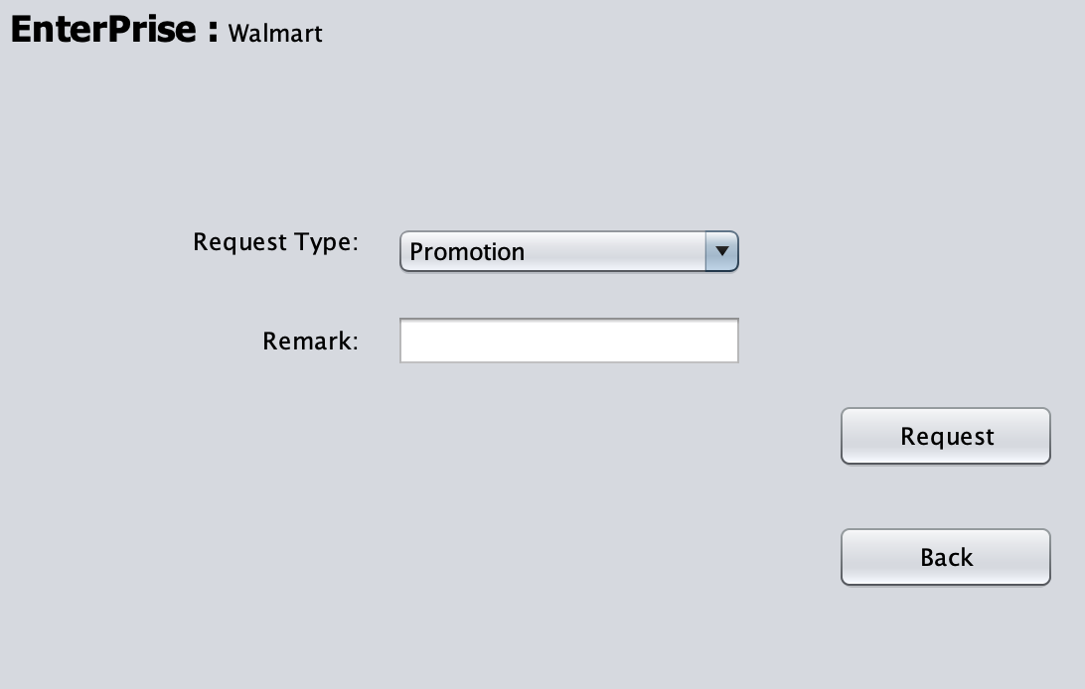
Market Seller Role

Slide 11
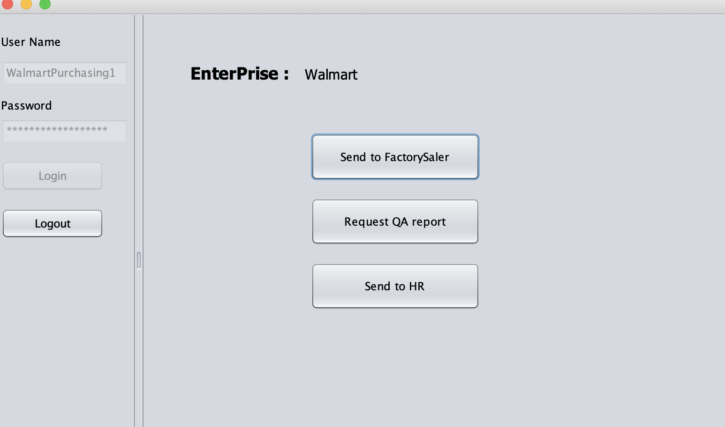
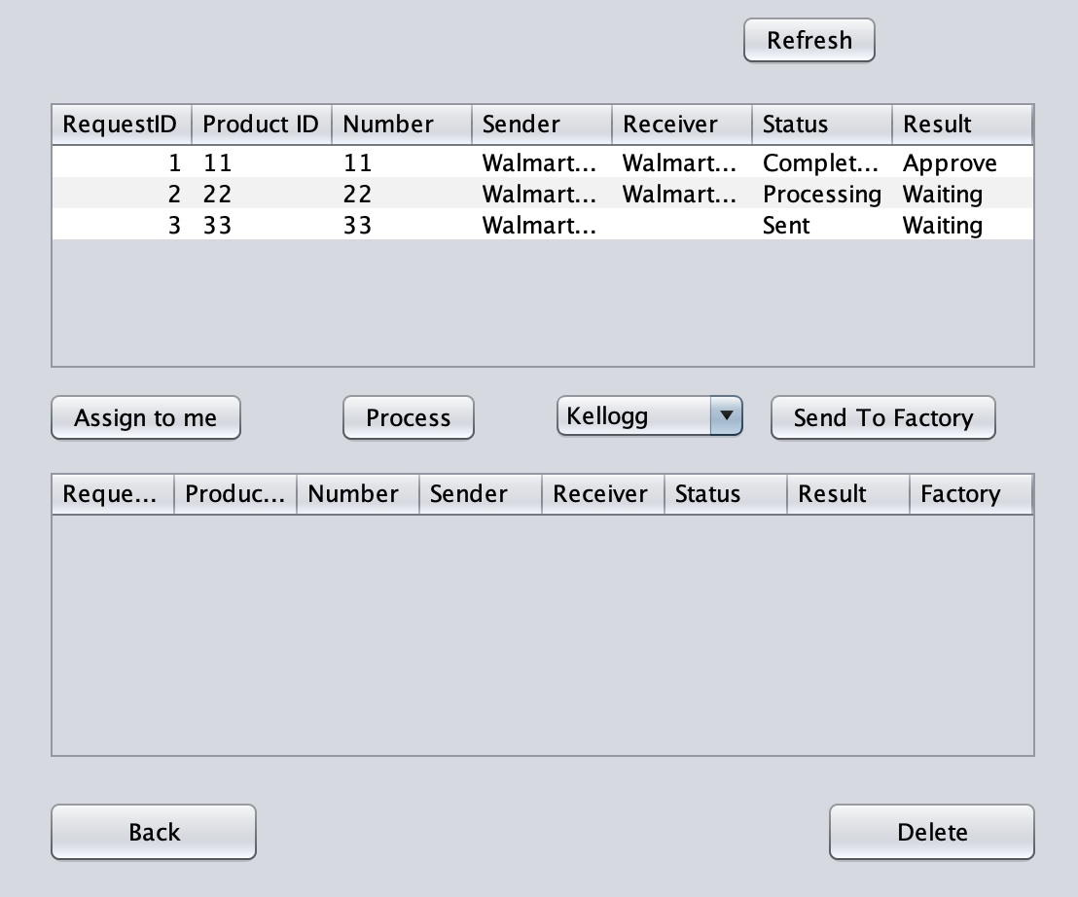
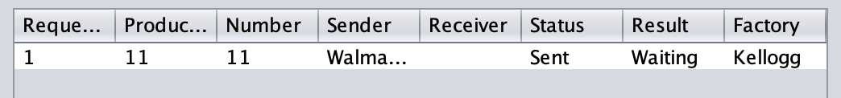
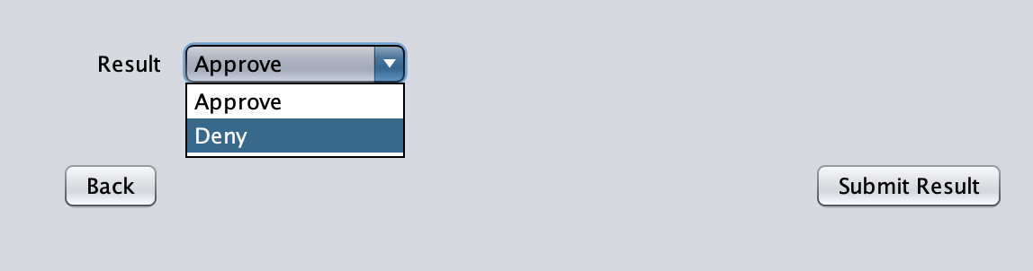
Market Purchaser Role

Slide 12
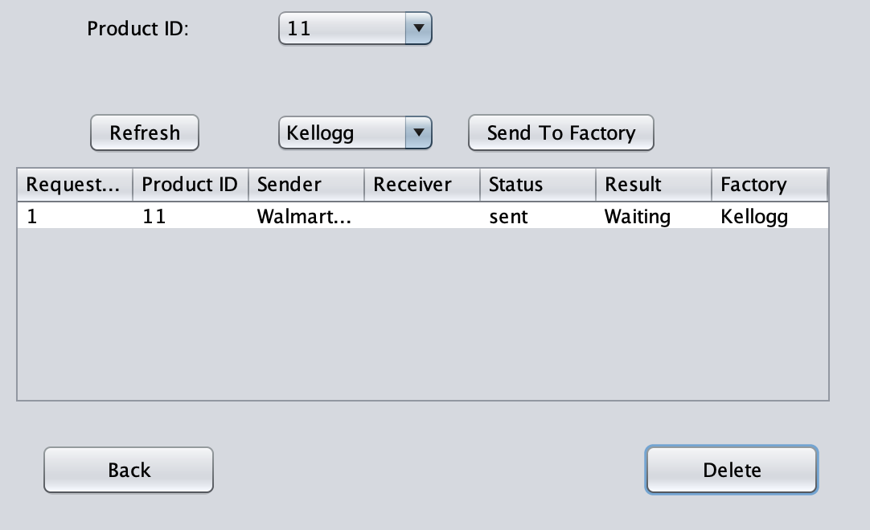
Market Purchaser Role

Slide 13
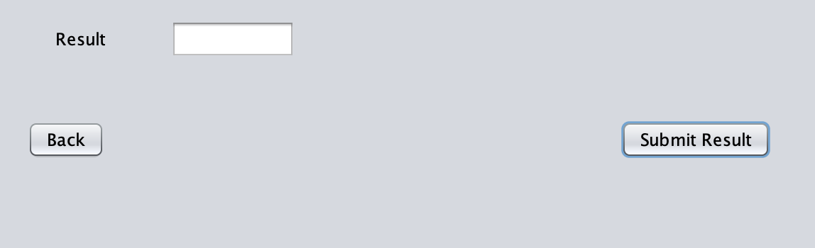
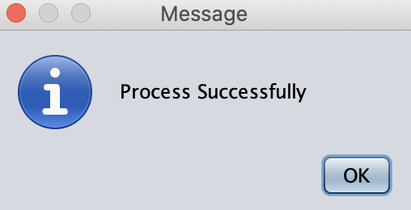
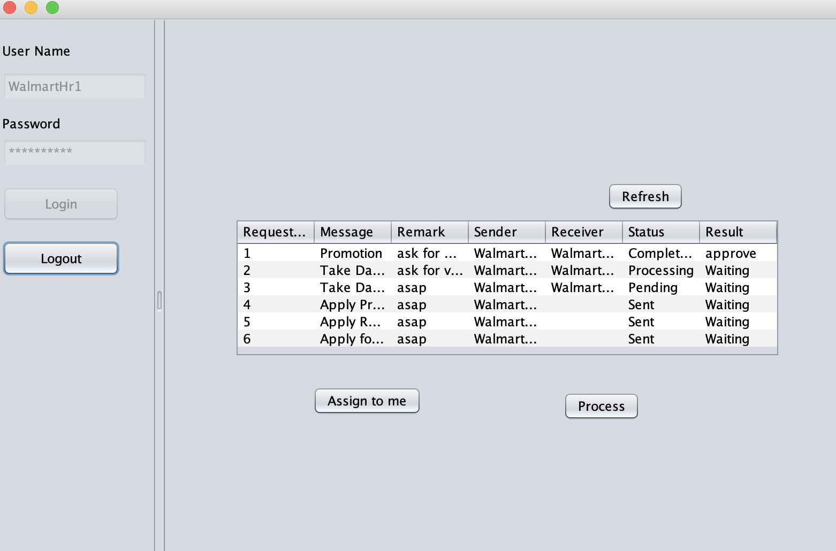
Market Hr Role

Slide 14
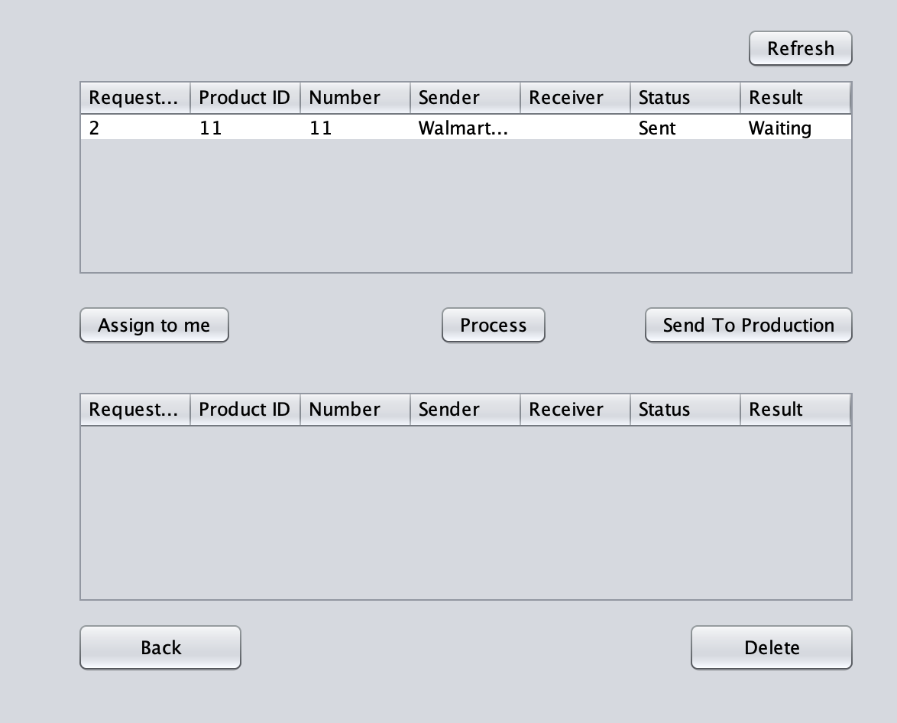
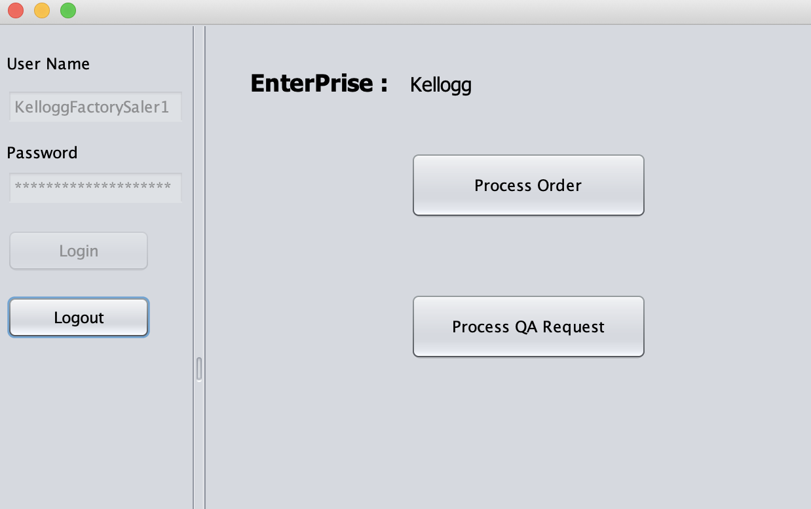
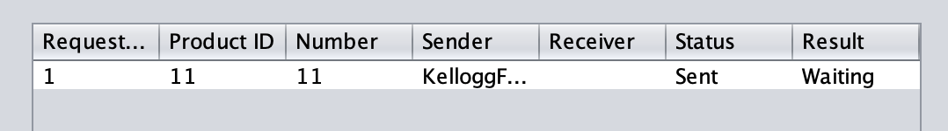
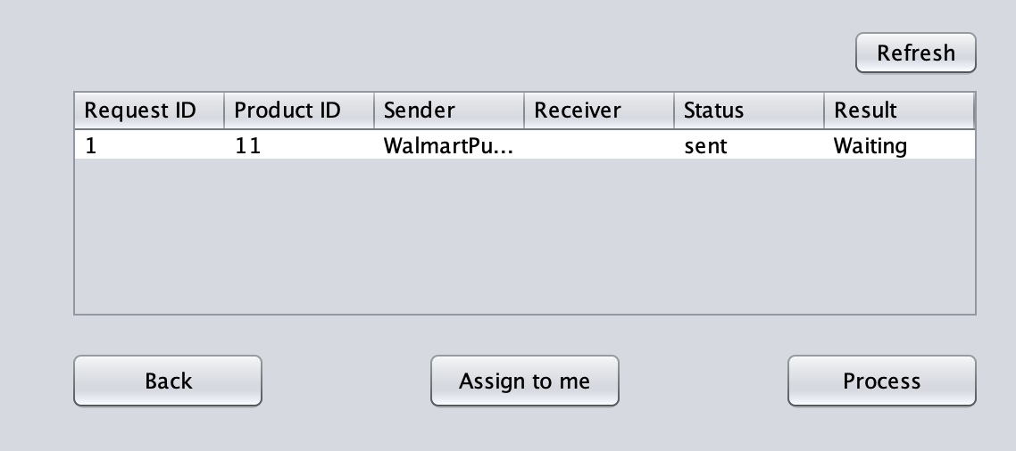
Factory Seller Role

Slide 15
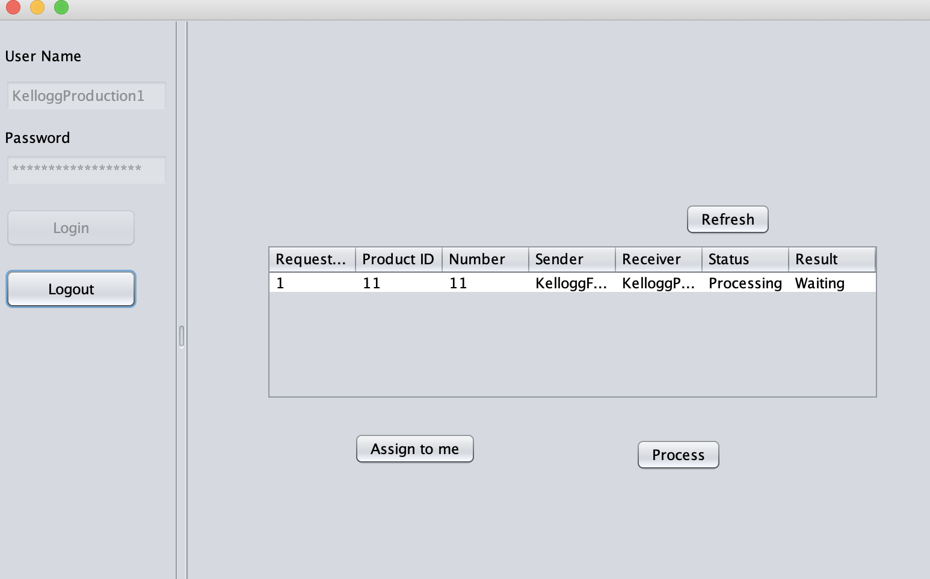
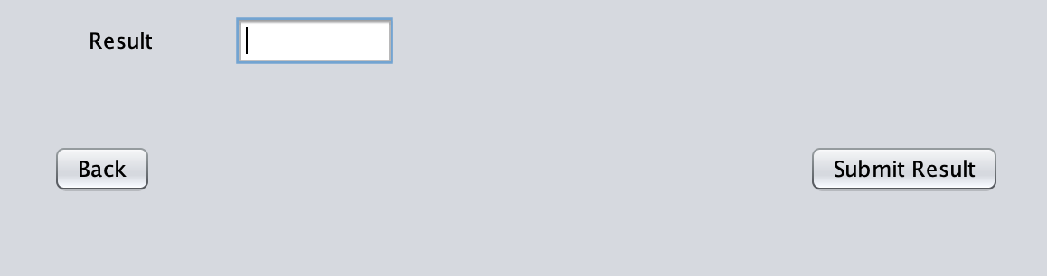
Production Role

Slide 16
Thank you!
Northeastern University

